Slide 1


Workshop
Talend
SCD Type 2
Create SCD process for Employee Department History

Slide 2
Assignment
Workshop files on NEU OneDrive folder \Talend - SCD Example
Sources & Targets:
Source: csv file - EmployeeDeptHistory.csv
Target: neu_workshops – My SQL Server
Table: EmployeeDeptHistory_scd
Preparation:
Create neu_workshops database – MySQL
Create EmployeeDeptHistory_scd in neu_workshops database using script “create_table_EmployeeDeptHistory_scd_mysql_tutorial.sql”

Slide 3
Assignments - Tasks
Download source file & target SQL script from NEU SharePoint folder
Create MySQL database & table
Open Talend
Create Metadata
Add & retrieve schema for MySQL database
Add File delimited connection
Date is seen as a string & then as a date MM/DD/YYYY
Create SCD job
Run SCD job

Slide 4
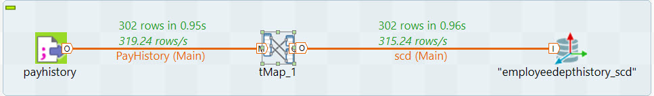
SCD Job

Slide 5
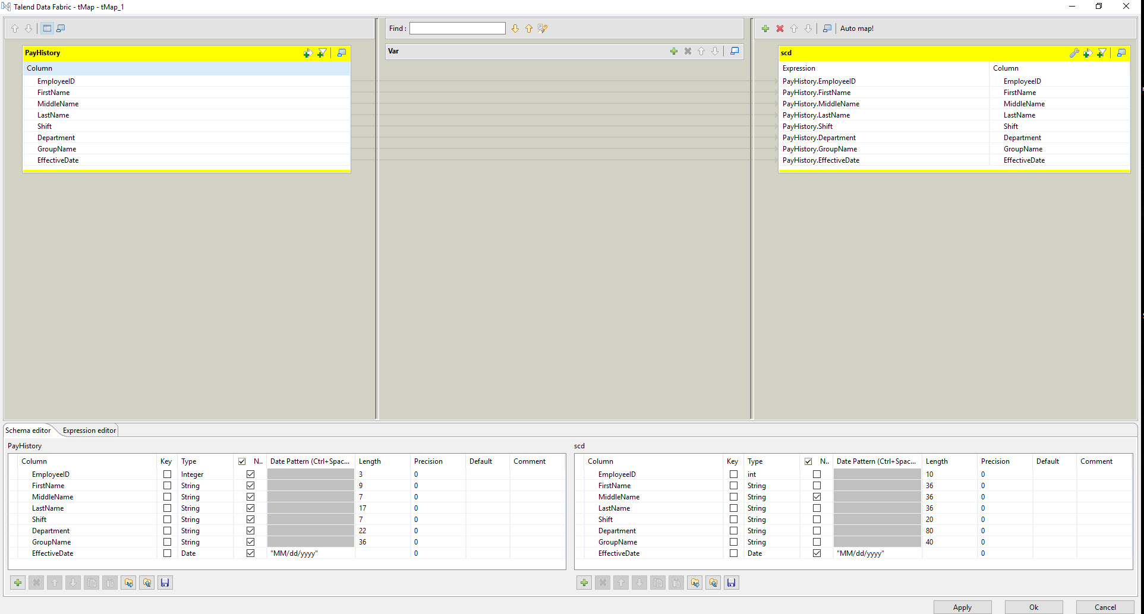
SCD Job - tMap

Slide 6
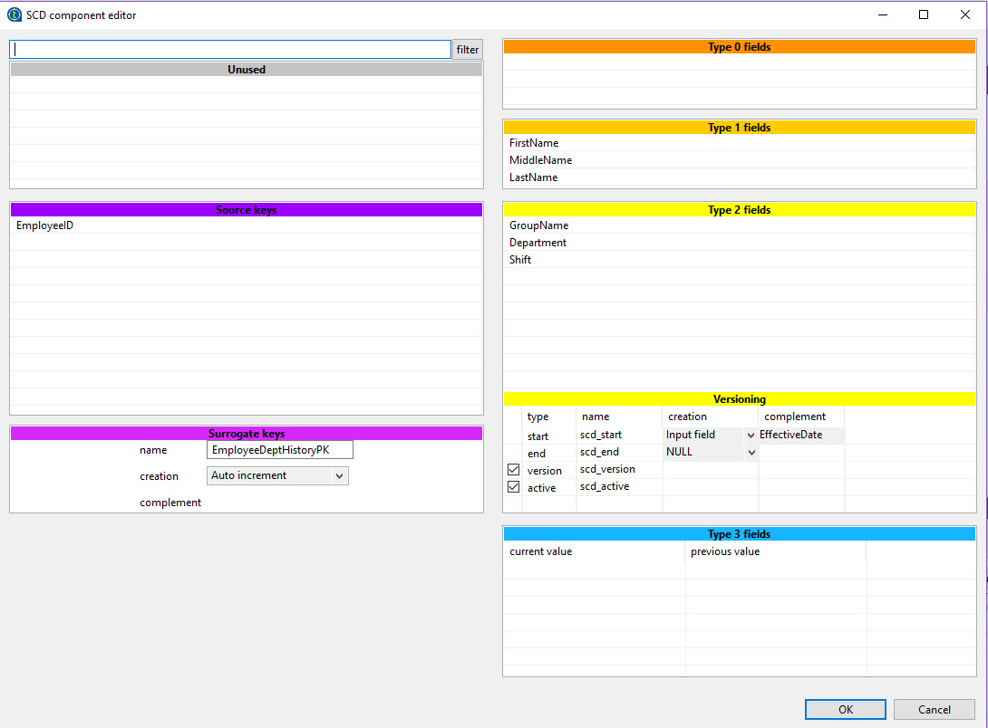
SCD Job – SCD Component Editor

Slide 7
Results
SELECT 'SCD Inactive', count(*) FROM employeedepthistory_scd where scd_active = 0
union
SELECT 'SCD Active', count(*) FROM employeedepthistory_scd where scd_active = 1
SCD Inactive | count(*)
SCD Inactive | 12
SCD Active | 290

Slide 8
Results
SELECT *
FROM employeedepthistory_scd
where scd_active = 0
;

Slide 9
Results
SELECT *
FROM neu_training.employeedepthistory_scd
where scd_active = 1 limit 10
;

